Slide 1








ArcGIS API for JavaScript: Creating Custom Layers and Layer Views
Sean McGee Jacob Wasilkowski
@HertsWestUK @JWasilGeo
2021 ESRI DEVELOPER SUMMIT

Slide 2






Going Beyond the JSAPI Layer
Images and Tiles
BaseDynamicLayer
BaseElevationLayer
2D Graphics
3D Graphics
BaseTileLayer
externalRenderers
BaseLayerView2D
BaseLayerViewGL2D
Choose your adventure!
Preprocess images
Manipulate elevations
Connect to a unique service(s)
…OR YOU COULD…
Draw your own 2D or 3D graphics
Bring your dreams to life with Canvas or WebGL

Slide 3

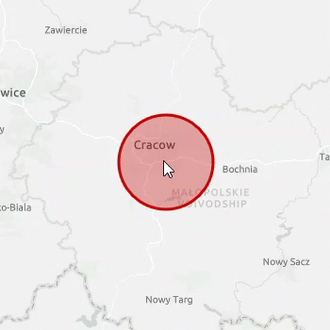


Hello World!
A custom and animated BaseLayerView2D
Review a simple GraphicsLayer
Compare with a BaseLayerView2D
Animate it!
https://github.com/jwasilgeo/esri-experiments

Slide 4
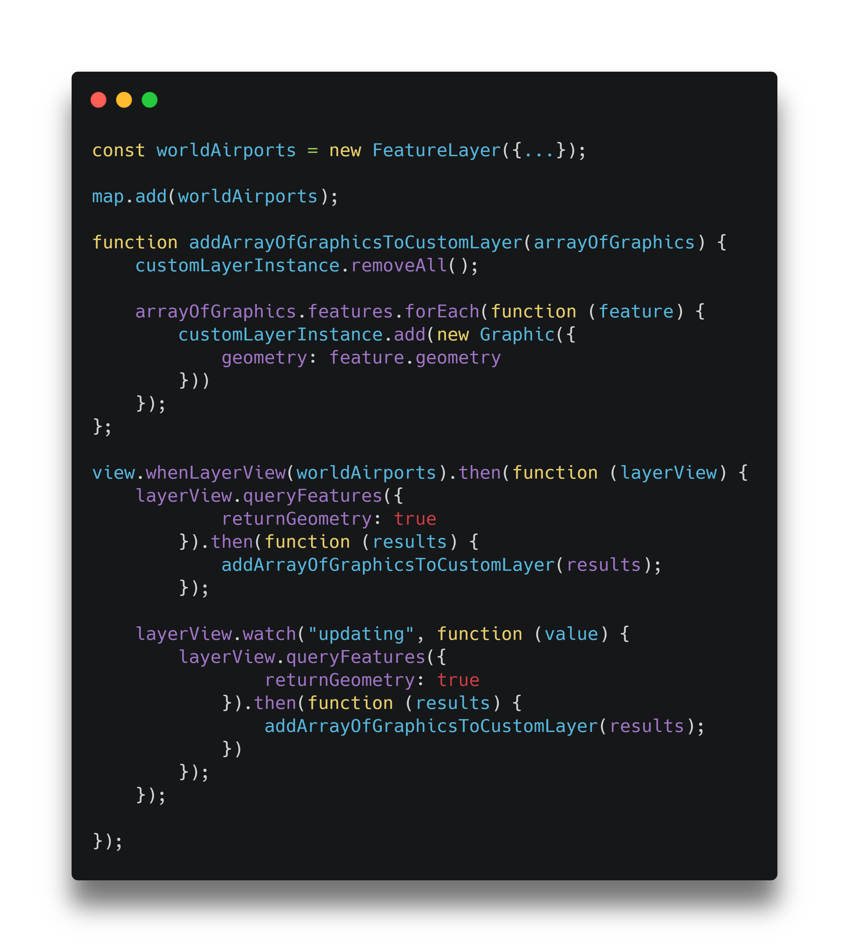
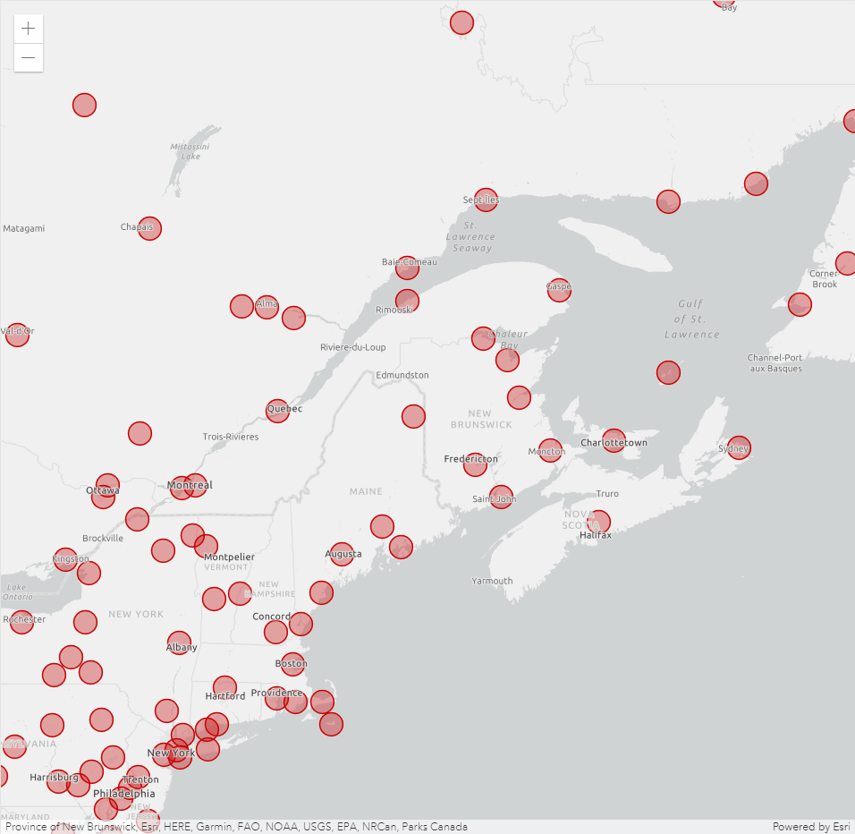
Custom Layer from Feature Layer – Animated points
codepen.io/hertswestuk/pen/mdOENve

Slide 5
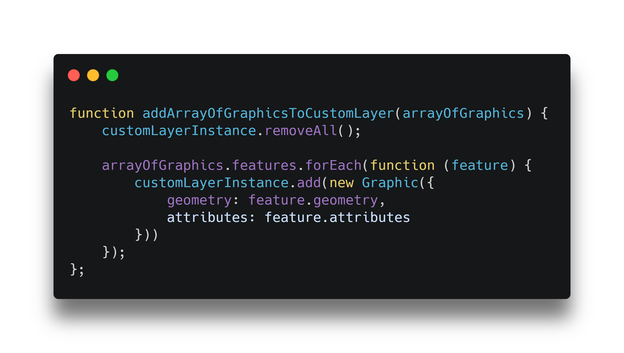
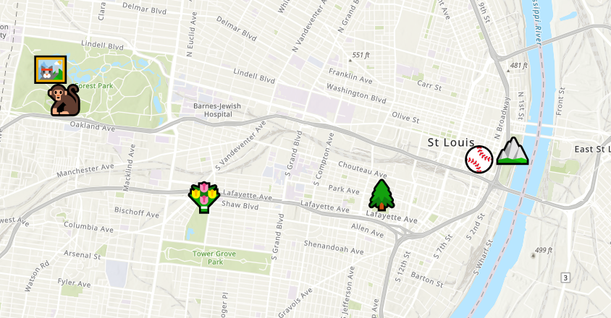
Custom Layer from Feature Layer – Accessing attribute data
@gavinrehkemper
gavinr.github.io/emoji-map-layer

Slide 6
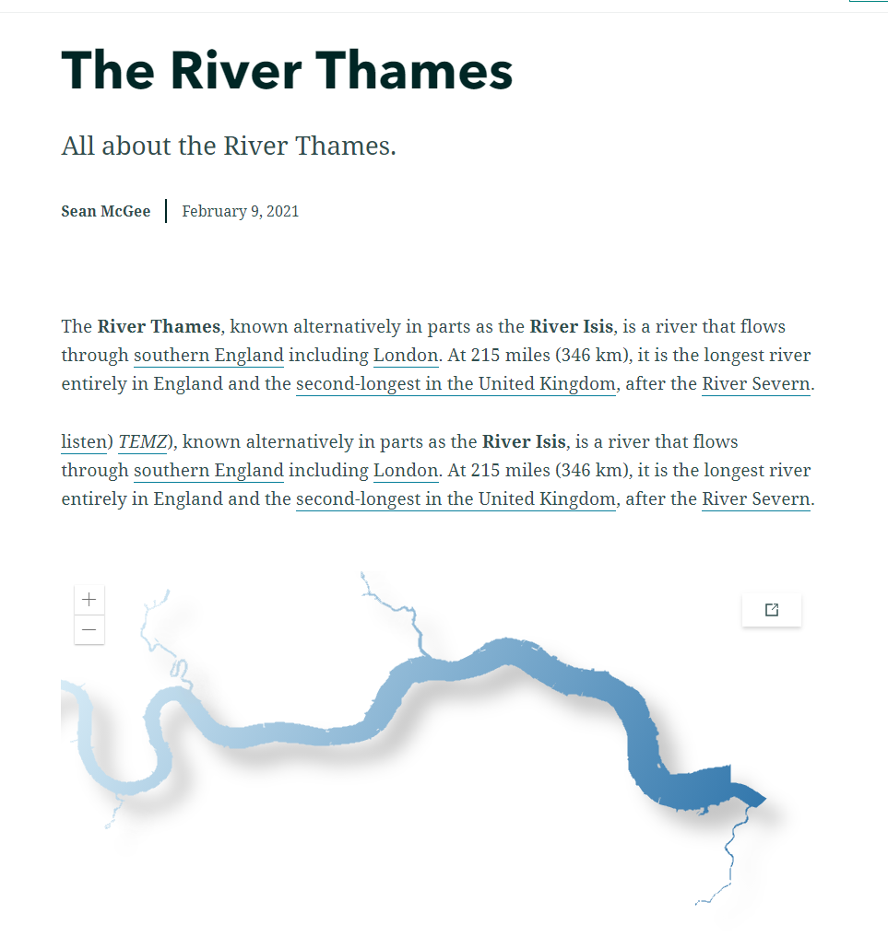
Demo
Using canvas stylings made by Sean McGee
codepen.io/hertswestuk/pen/LYbZwvK

Slide 7








Utilizing Canvas

Slide 8
Blending sample
2 overlapping square symbols with a solid colour (yellow and red).
Yellow
Red
Yellow
Red
No blend option
Symbol blend option enabled

Slide 9
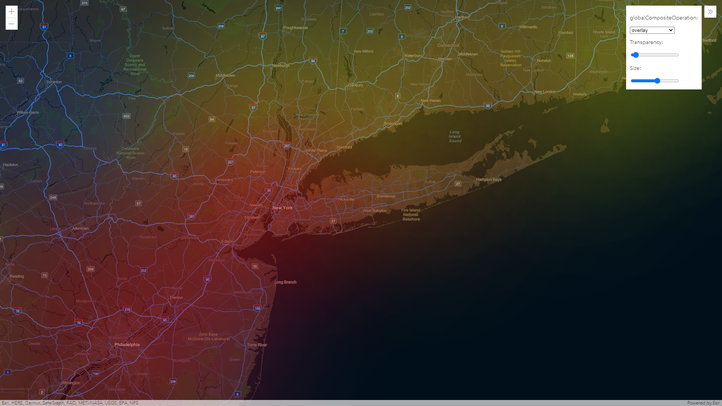
Demo
Using canvas blending made by Sean McGee
codepen.io/hertswestuk/pen/LYbZwvK

Slide 10
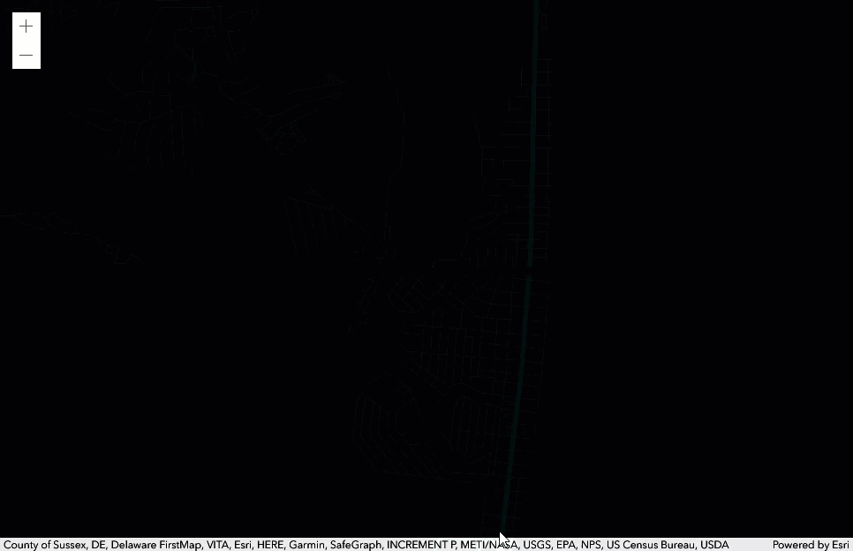
Demo
A custom BaseLayerView2D made by Sean McGee
https://codepen.io/smcgee/pen/KKpKPxW

Slide 11
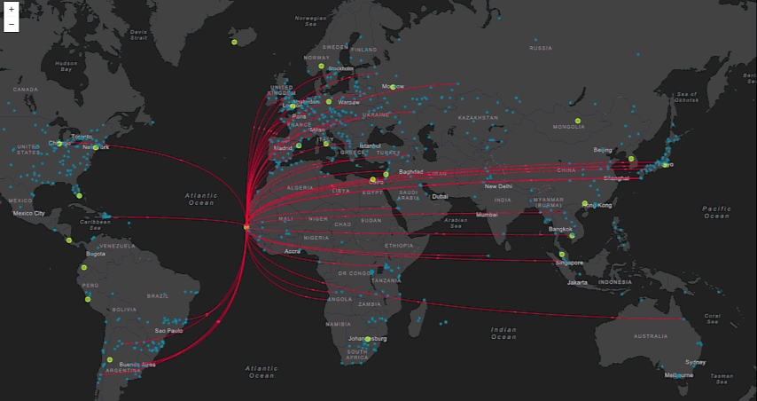
Demo
“Canvas-Flowmap-Layer”
A custom BaseLayerView2D made by Sarah Bell and Jacob Wasilkowski
@sarahbellmaps
https://github.com/sarahbellum/Canvas-Flowmap-Layer

Slide 12
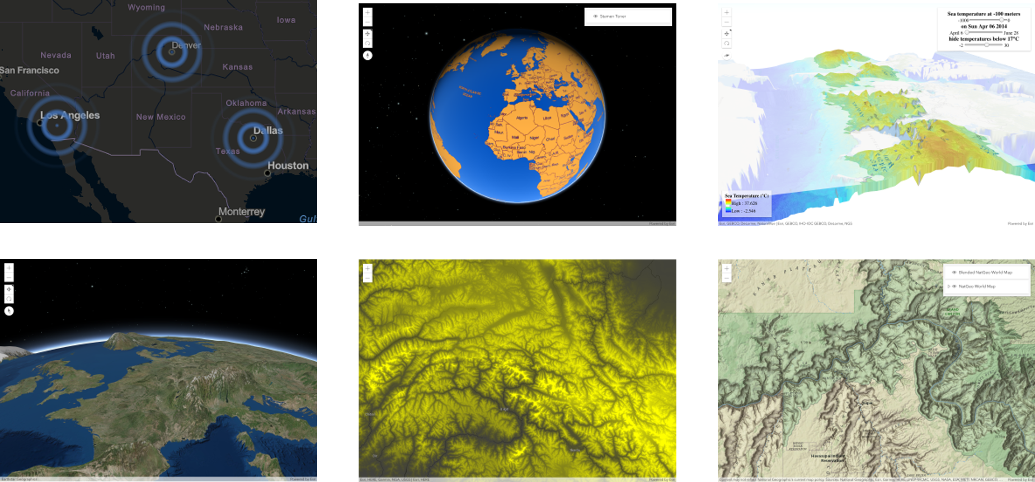
JSAPI Examples of What’s Possible: https://esriurl.com/jsCustomLayers

Slide 13
Resources
These slides are available at
https://github.com/jwasilgeo/presentations
Dev Summit 2019: “ArcGIS API for JavaScript: Creating Custom Layers and Layer Views”
https://proceedings.esri.com/library/userconf/devsummit19/papers/DevSummitPS_10.pdf
Dev Summit 2018: “ArcGIS API for JavaScript: Creating Custom Layers”
https://proceedings.esri.com/library/userconf/devsummit18/papers/dev-int-018.pdf

Slide 14









Copyright © 2021 Esri. All rights reserved.

Slide 15
Please provide your feedback for this session by clicking on the session survey link directly below the video.

